Slide 1
Development of C language

Slide 2
A large number of researchers have contributed to the development of C. For example, Lesk wrote a portable input/output package which was later modified to become C standard I/O routines. In 1978, Brian Kernighan and Ritchie authored a book entitled “The C Programming Language”, which gave the basic framework of C and remained a reference book for many years. However, in a few years following the publication of the book, the language in actual use was developed much beyond the book. It was felt that it needed formal standardization. In the year 1983, ANSI established a committee called X3J11, for the purpose. The committee produced a report (ANSI 89) towards the end of 1989. The report was accepted by ISO and became the standard ISO/IEC 9899-1990, Programming Language – C. The language according to standard is also called C-90.
The standardization gave another push to the development process of the language. During the same period (1983-85) another language, C++, was developed by Bjarne Stroustrup. The concept of classes was introduced into C to make it an object-oriented programming language and a new name C++ was given to the language. Some of the features introduced in C++ certainly give an advantage over the version of C-90. However, in 1999 it was again felt that C needs another revision because many new developments had taken place as well as problems with the standard became clear. A revised standard was accepted by ISO in 1999. New keywords and header files were included in the language. This document is known as ISO/IEC 9899-1999, Programming language – C. The language according to this standard is known as C-99. It is in vogue at present though many compilers are yet to be revised to the new standard and still follow C-90 language. The development of C is also illustrated in Fig

Slide 3
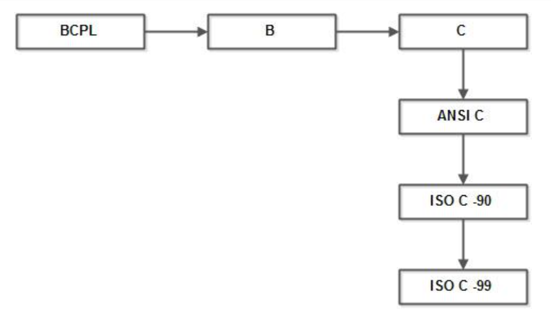

Slide 4
Characteristics:
Like most imperative languages in the ALGOL tradition, C has facilities for structured programming and allows lexical variable scope and recursion, while a static type system prevents many unintended operations. In C, all executable code is contained within functions. Function parameters are always passed by value. Pass-by-reference is simulated in C by explicitly passing pointer values.
Heterogeneous aggregate data types (struct) allow related data elements to be combined and manipulated as a unit. C program source text is free-format, using the semicolon as a statement terminator.
C also exhibits the following more specific characteristics:
Variables may be hidden in nested blocks Partially weak typing. for instance, characters can be used as integers. Low-level access to computer memory by converting machine addresses to typed pointers Function and data pointers supporting ad hoc run-time polymorphism array indexing as a secondary notion, defined in terms of pointer arithmetic.
A preprocessor for macro definition, source code file inclusion, and conditional compilation Complex functionality such as I/O, string manipulation, and mathematical functions consistently delegated to library routines A relatively small set of reserved keywords A large number of compound operators, such as +=, -=, *=, ++ etc.

Slide 5
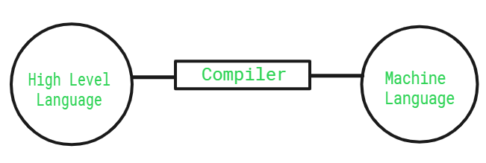
Role of a Compiler
For Converting the code written in a high-level language into machine-level language so that computers can easily understand, we use a compiler. Converts basically convert high-level language to intermediate assembly language by a compiler and then assembled into machine code by an assembler.

Slide 6
Advantages of Compiler
Compiled code runs faster in comparison to Interpreted code.
Compilers help improve the security of Applications.
Compilers give Debugging tools, which help in fixing errors easily.
Disadvantages of Compiler
The compiler can catch only syntax errors and some semantic errors .
Compilation can take more time in the case of bulky code.

Slide 7
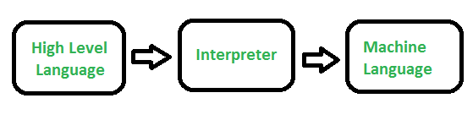
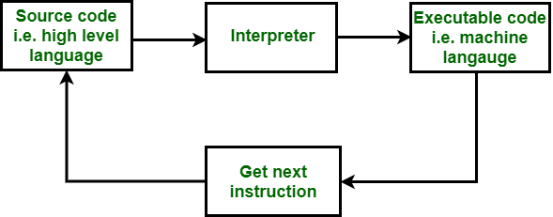
What is an Interpreter?
An Interpreter is a program that translates a programming language into a comprehensible language. The interpreter converts high-level language to an intermediate language. It contains pre-compiled code, source code, etc.
It translates only one statement of the program at a time.
Interpreters, more often than not are smaller than compilers.
Advantages of Interpreter
Programs written in an Interpreted language are easier to debug.
Interpreters allow the management of memory automatically, which reduces memory error risks.
Interpreted Language is more flexible than a Compiled language.
Disadvantages of Interpreter
The interpreter can run only the corresponding Interpreted program.
Interpreted code runs slower in comparison to Compiled code.

Slide 8
1. 2. 3. 4. 5.
Compiler | Interpreter
Steps of Programming: Program Creation. Analysis of language by the compiler and throws errors in case of any incorrect statement. In case of no error, the Compiler converts the source code to Machine Code. Linking of various code files into a runnable program. Finally runs a Program. | Steps of Programming: Program Creation. Linking of files or generation of Machine Code is not required by Interpreter. Execution of source statements one by one.
The compiler saves the Machine Language in form of Machine Code on disks. | The Interpreter does not save the Machine Language.
Compiled codes run faster than Interpreter. | Interpreted codes run slower than Compiler.
CPU utilization is more in the case of a Compiler. C, C++, C#, etc are programming languages that are compiler-based. | CPU utilization is less in the case of a Interpreter. Python, Ruby, Perl, SNOBOL, MATLAB, etc are programming languages that are interpreter-based.

Slide 9

An assembler is a computer program that translates assembly language code into machine code. It allows you to communicate directly with a computer’s hardware. It converts human-readable instructions into binary codes that the central processing unit (CPU) can execute. Assemblers are used for low-level programming and are specific to a particular computer architecture

Slide 10
